Slide 1



Education
Learn how git works to better contribute to open source
Federico Grandi - @EndBug - federicograndi@duck.com

Slide 2



Slide 3
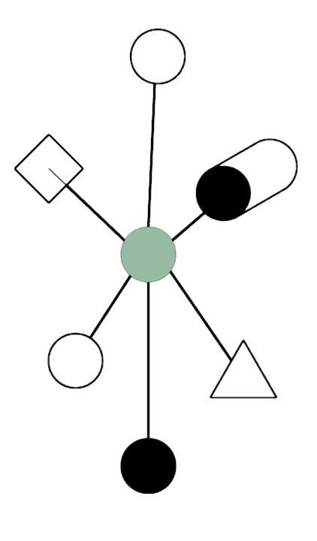
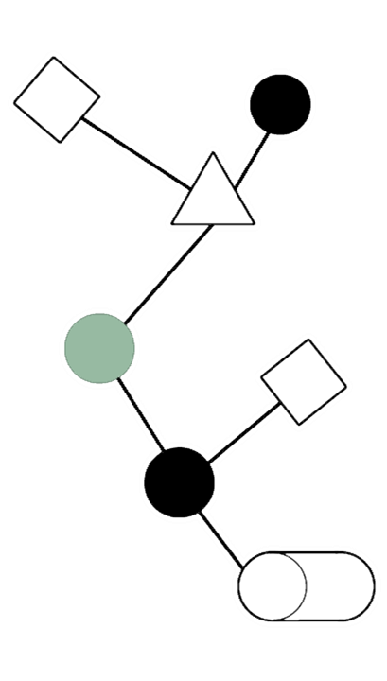

Slide 4






Web service
…

Slide 5


Slide 6
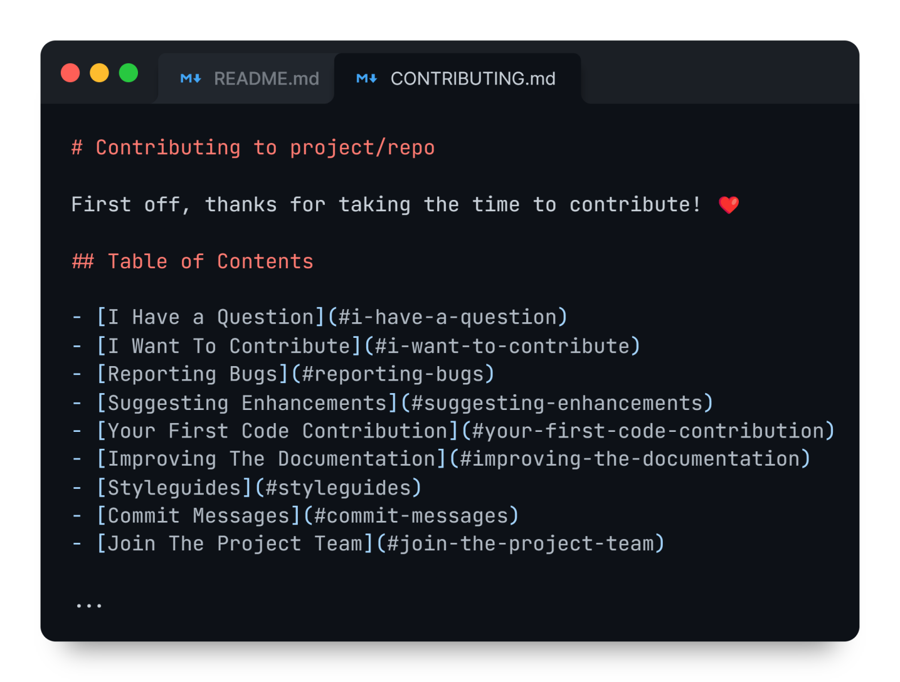

Slide 7

Search existing issues
Create one
Is it open and looking for a contribution?
Is it worth commenting? Should it be re-opened?
Is there already a WIP branch?

Slide 8

project/repo
you/repo

Slide 9

Timeline of a fork

Slide 10

Friendly forks

Slide 11




Branching and merging
main
feature

Slide 12
Popular naming conventions
Persistent branches
Feature branches
#123: Abc!
abc 123-abc
123-fix-abc
UserName/issue-123
UserName/123/fix-abc
main master dev stable v12.3.x
release-1.23

Slide 13

Single Responsibility Principle
Atomic commits:
Minimal Complete Isolate

Slide 14
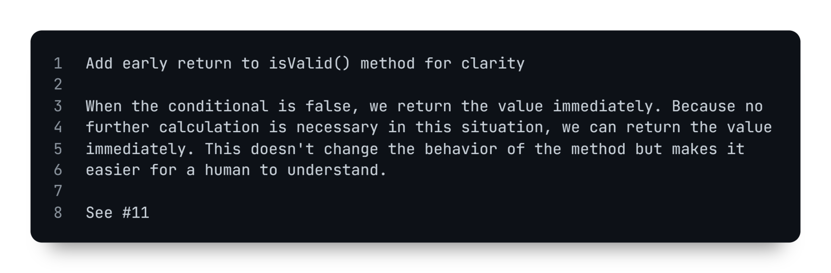
Commit messages
Short (max 50 chars), imperative, capitalized, no period
Wraps at 72~80 chars, explains the thinking behind the commit
Reference to issue/ticket
Blank lines to separate sections

Slide 15
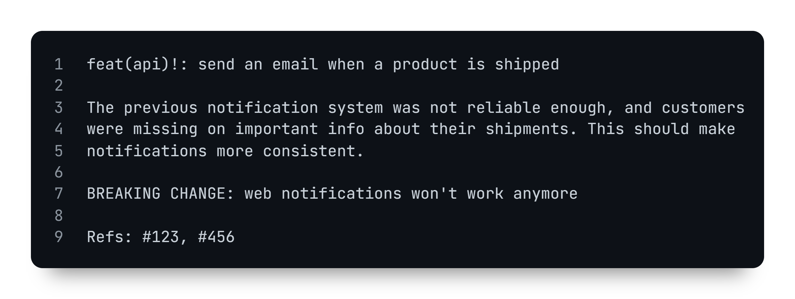
conventionalcommits.org / Angular convention
type scope breaking changes indicator
description
body
breaking changes
footer

Slide 16
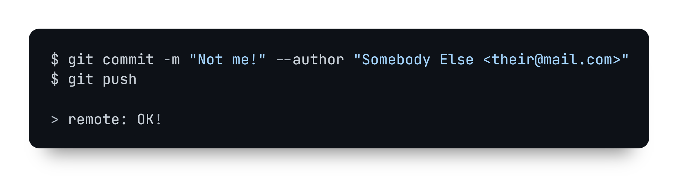

GPG signing

Slide 17

GPG signing
Upload your public GPG key
Sign your commit
Commits will now be marked as
either "Verified" or "Unverified"

Slide 18

Running checks
(build, lint, test, …)
Manually
Using git hooks
Using CI/CD workflows

Slide 19
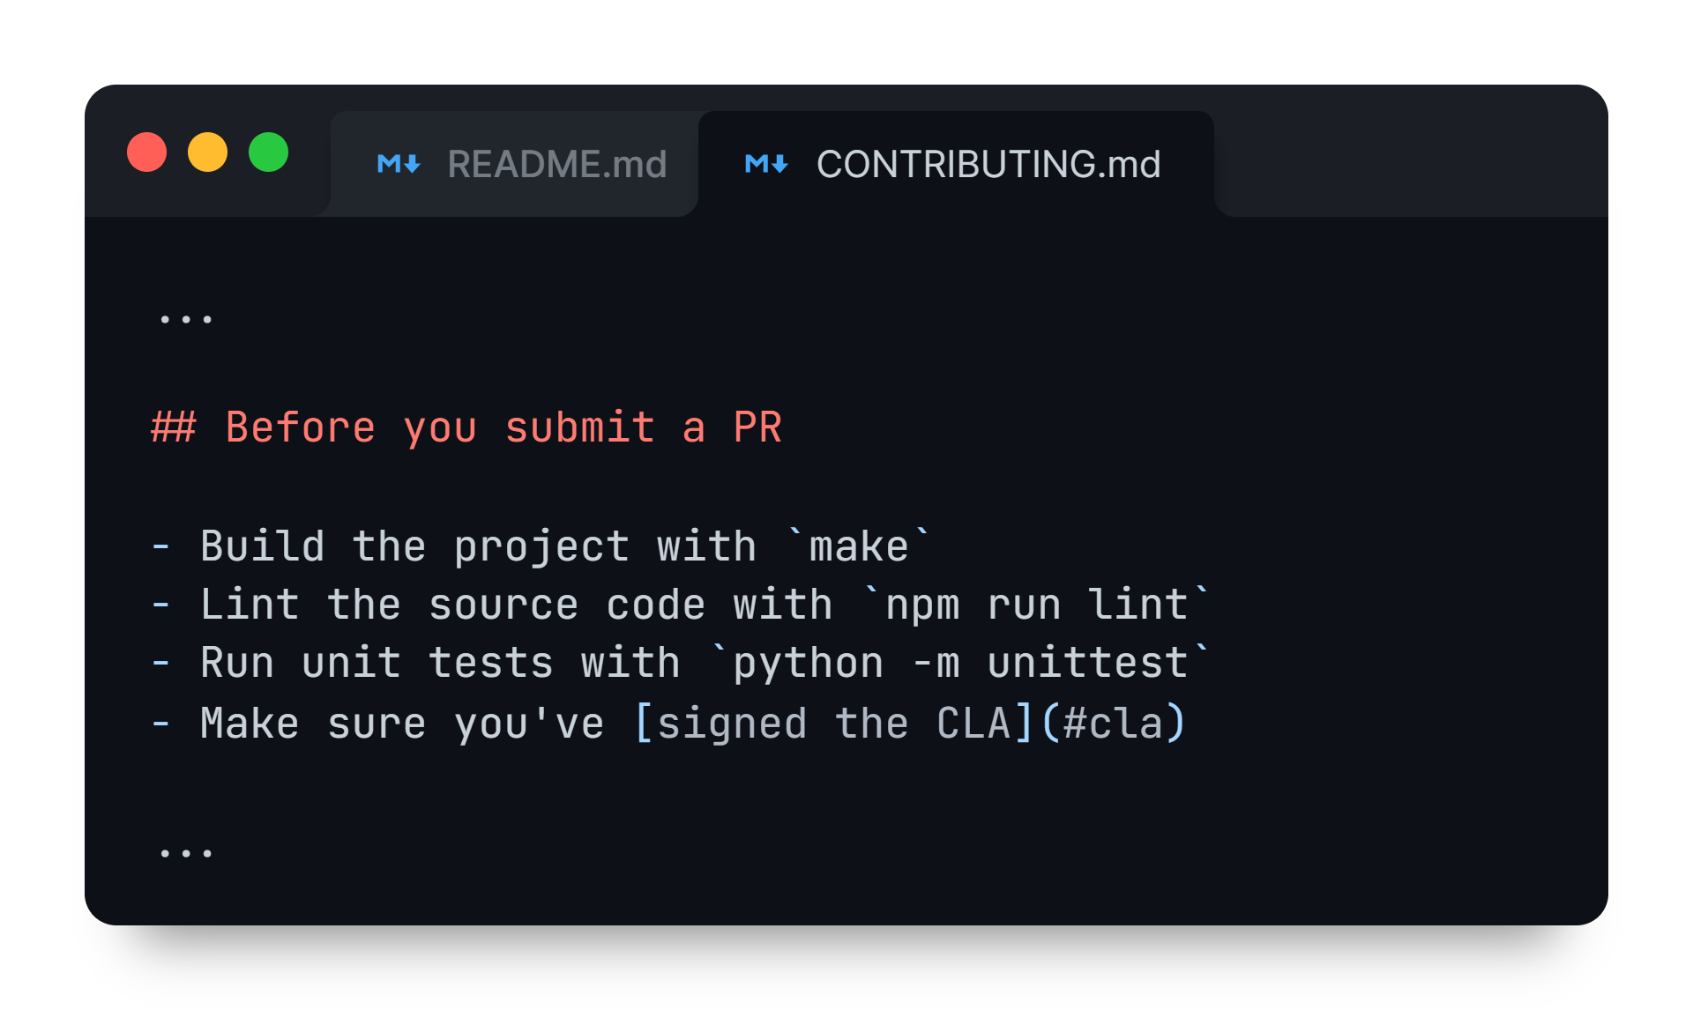
Running manual checks

Slide 20
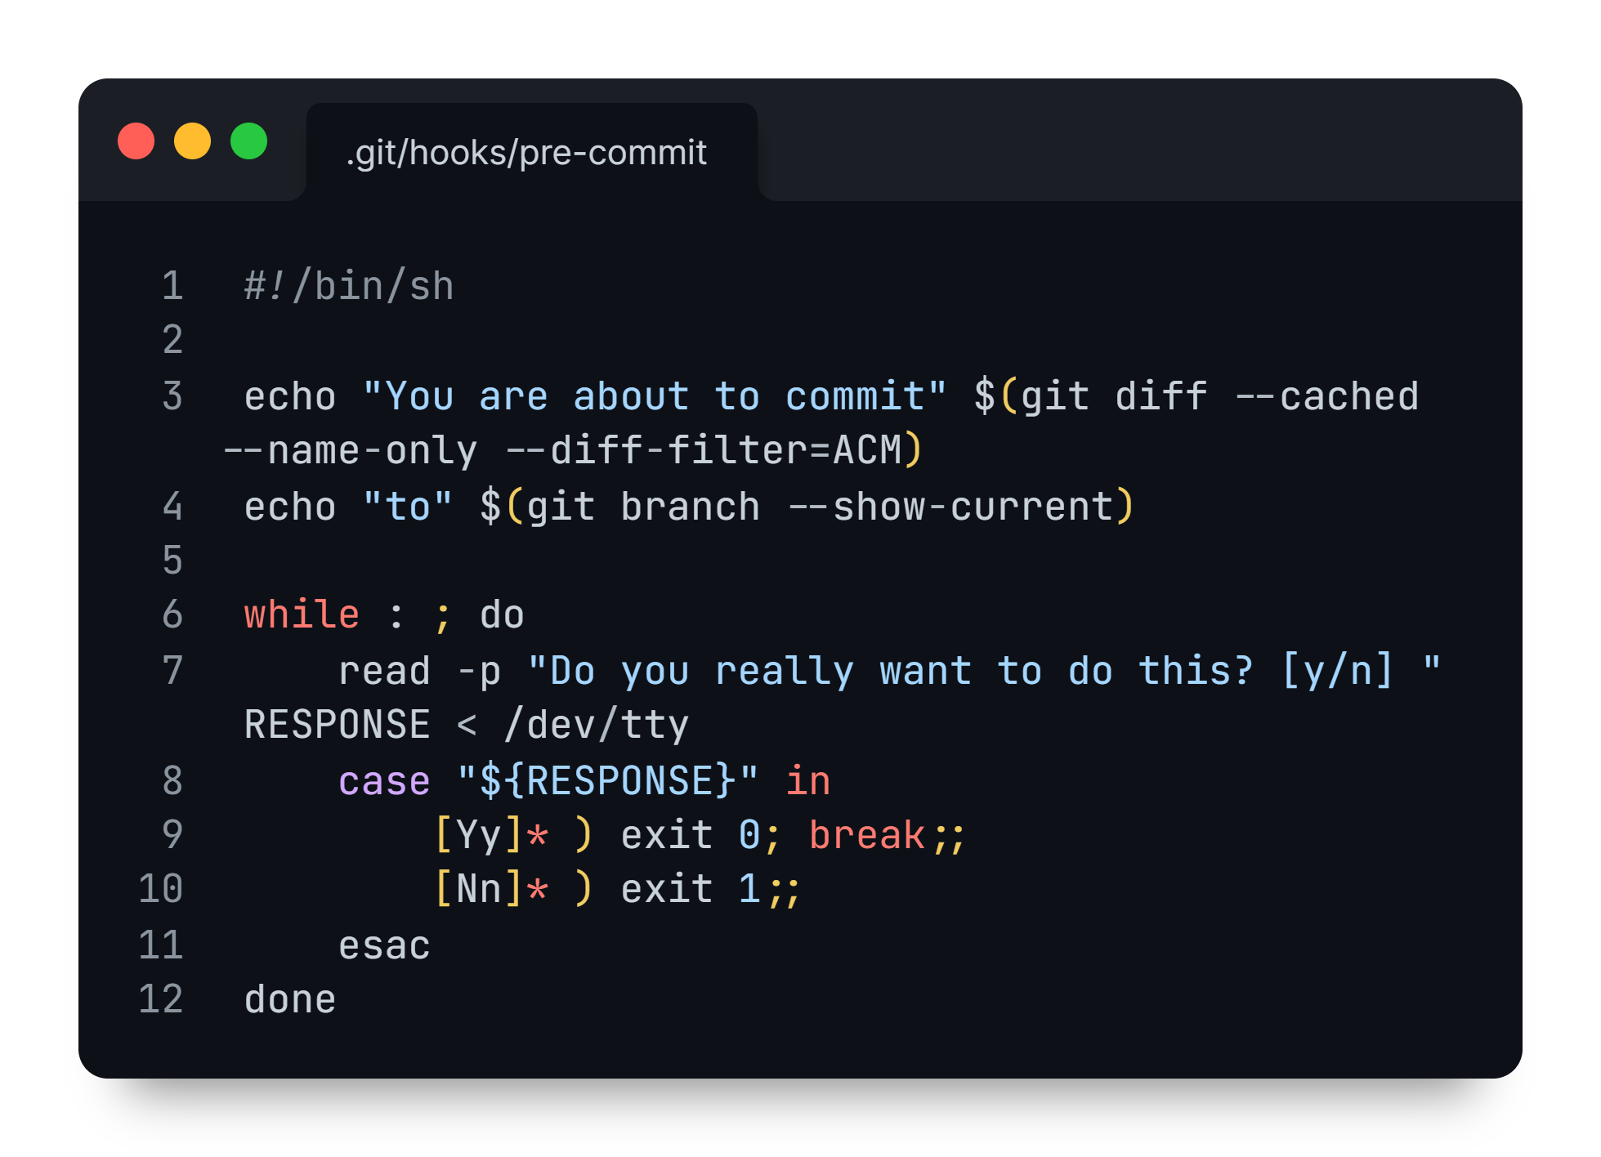
Using git hooks
pre-commit commit-msg post-commit update
pre-push
pre-receive
...

Slide 21
Using CI/CD workflows
build lint test
...

Slide 22
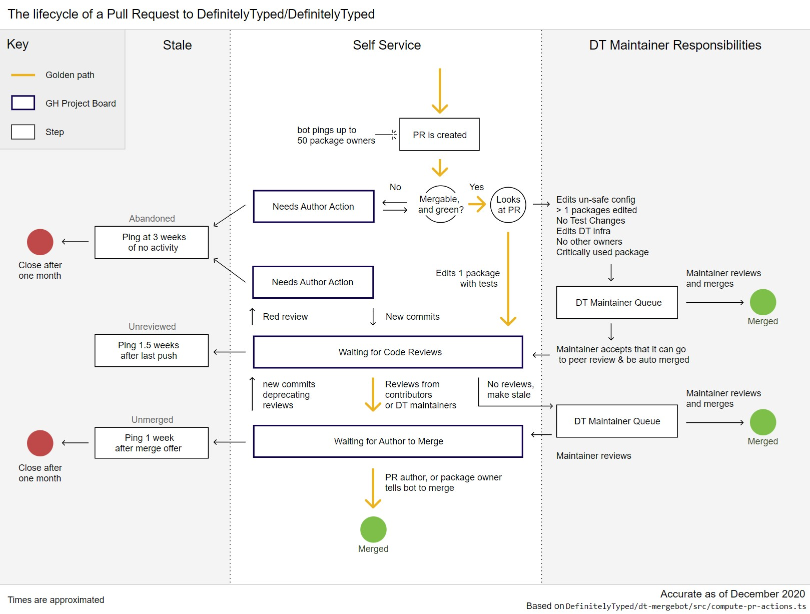
Using CI/CD workflows

Slide 23
Unit testing

Slide 24
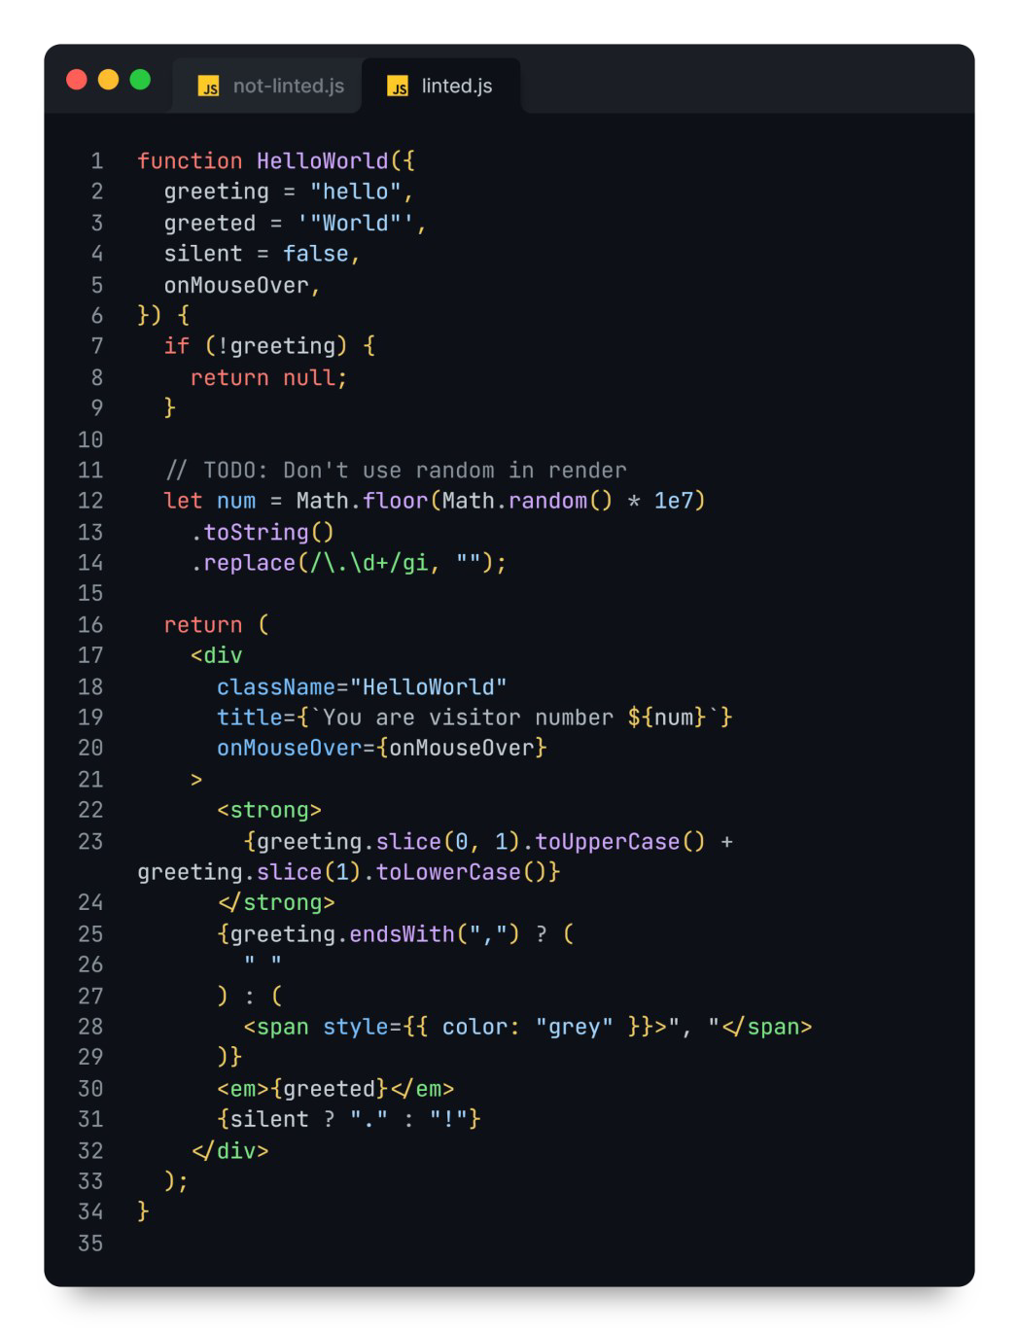
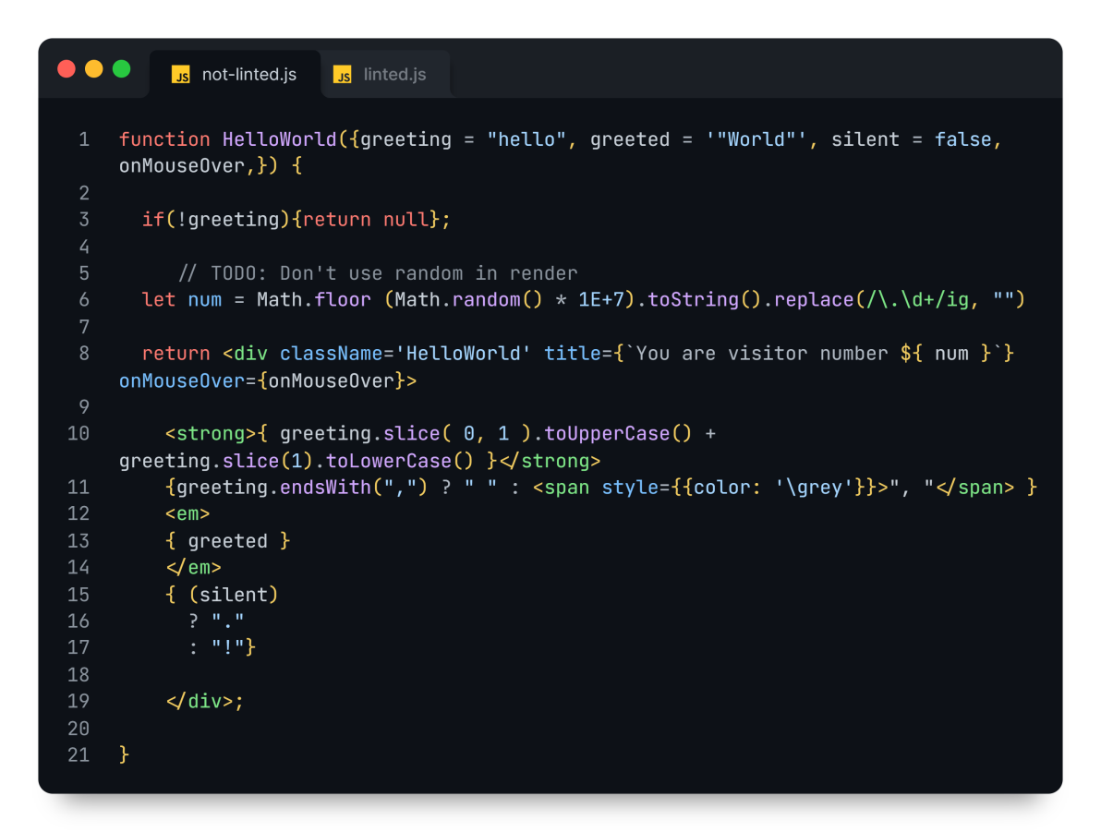
Linting

Slide 25


Slide 26


Slide 27

"Editing" a commit
Rewriting the history
Locally
On the remote

Slide 28
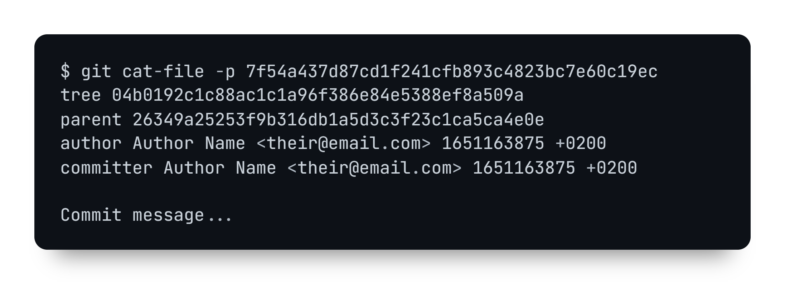
SHA generated with git hash-object
Commit tree
Parent
commit
Commit info

Slide 29
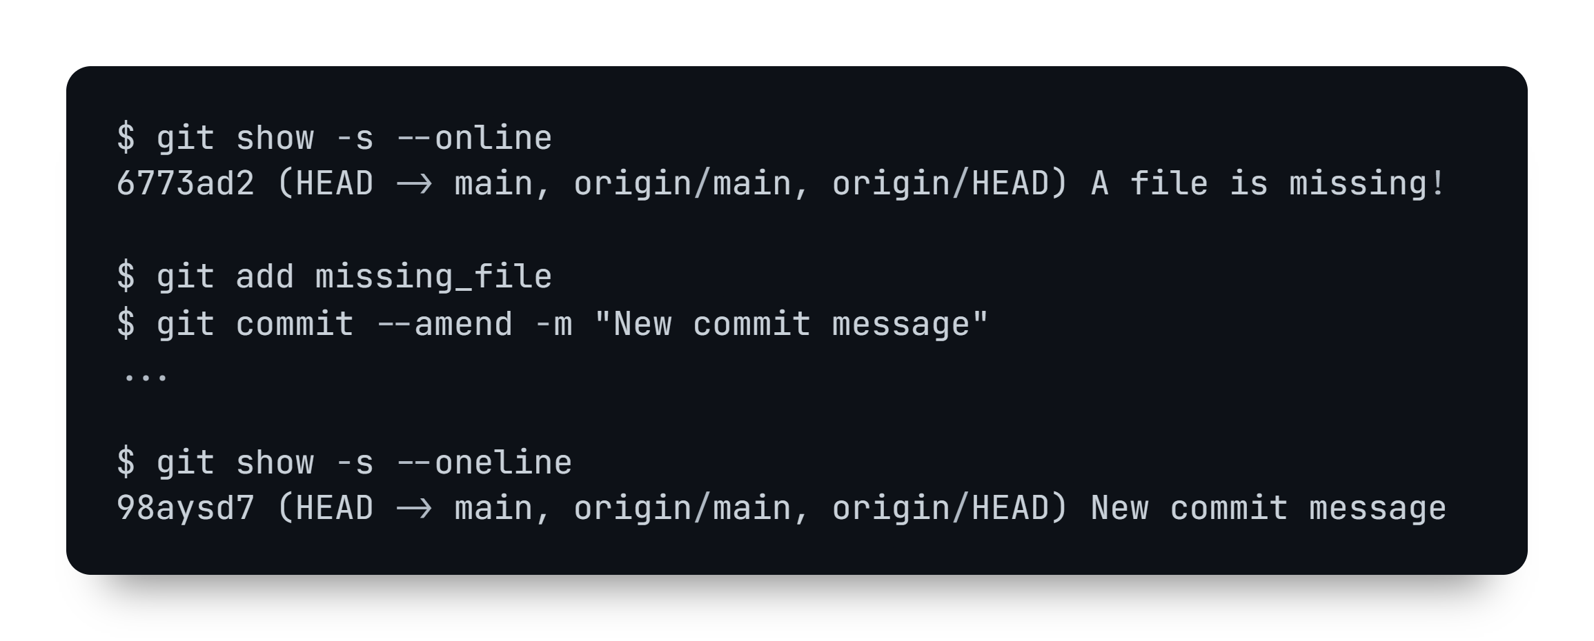
git commit --amend

Slide 30
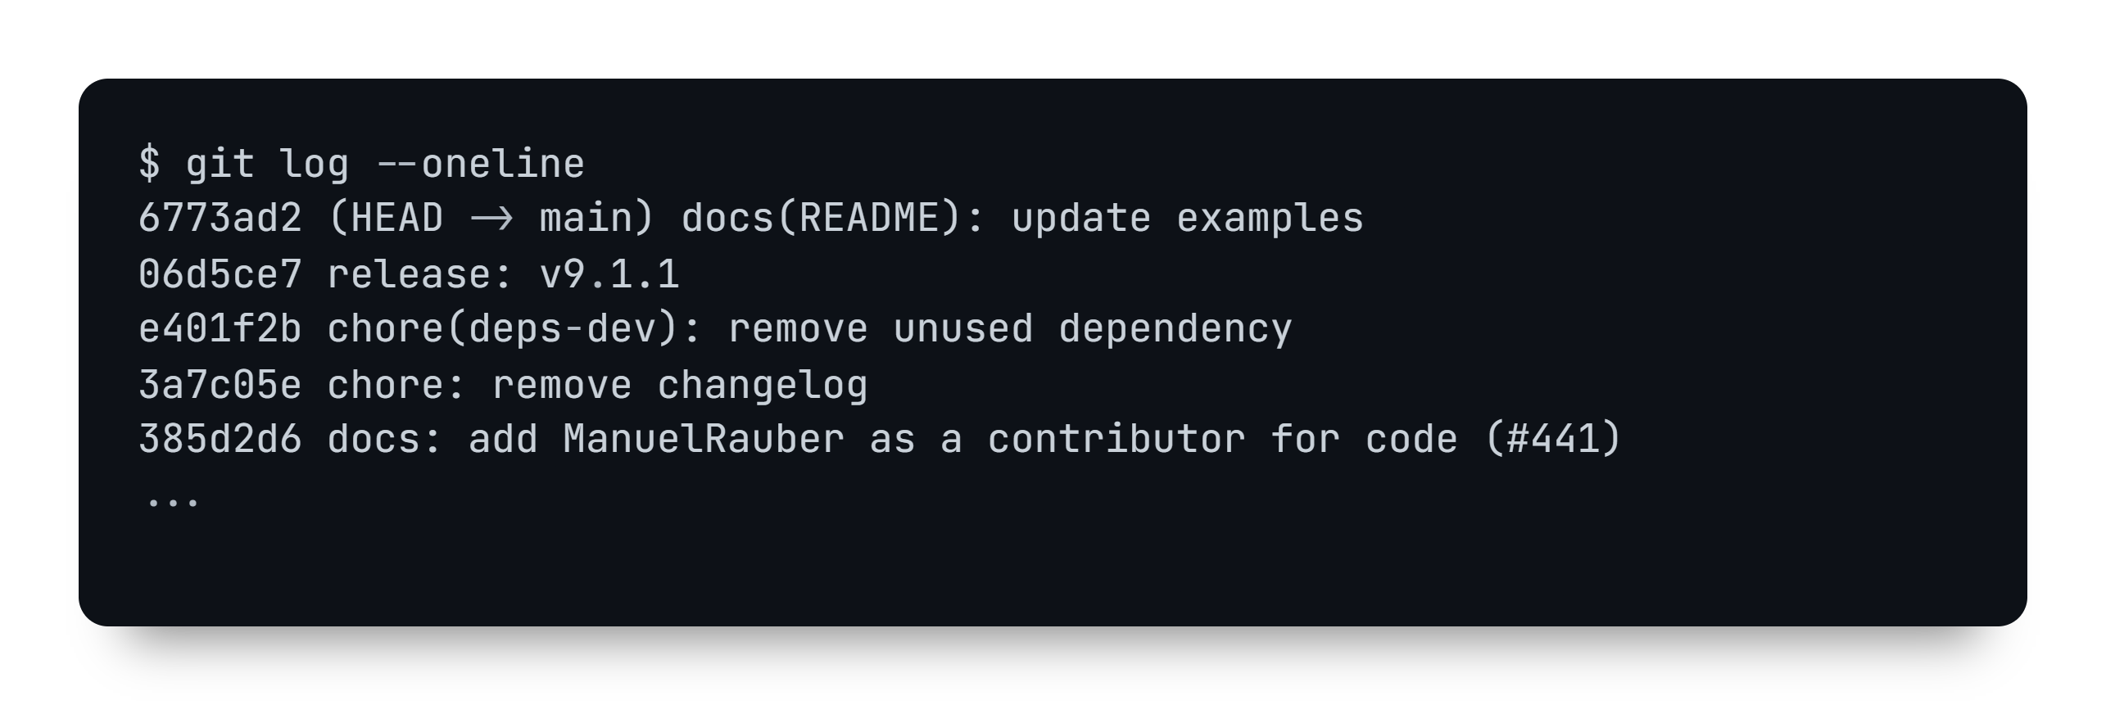
git rebase –i

Slide 31
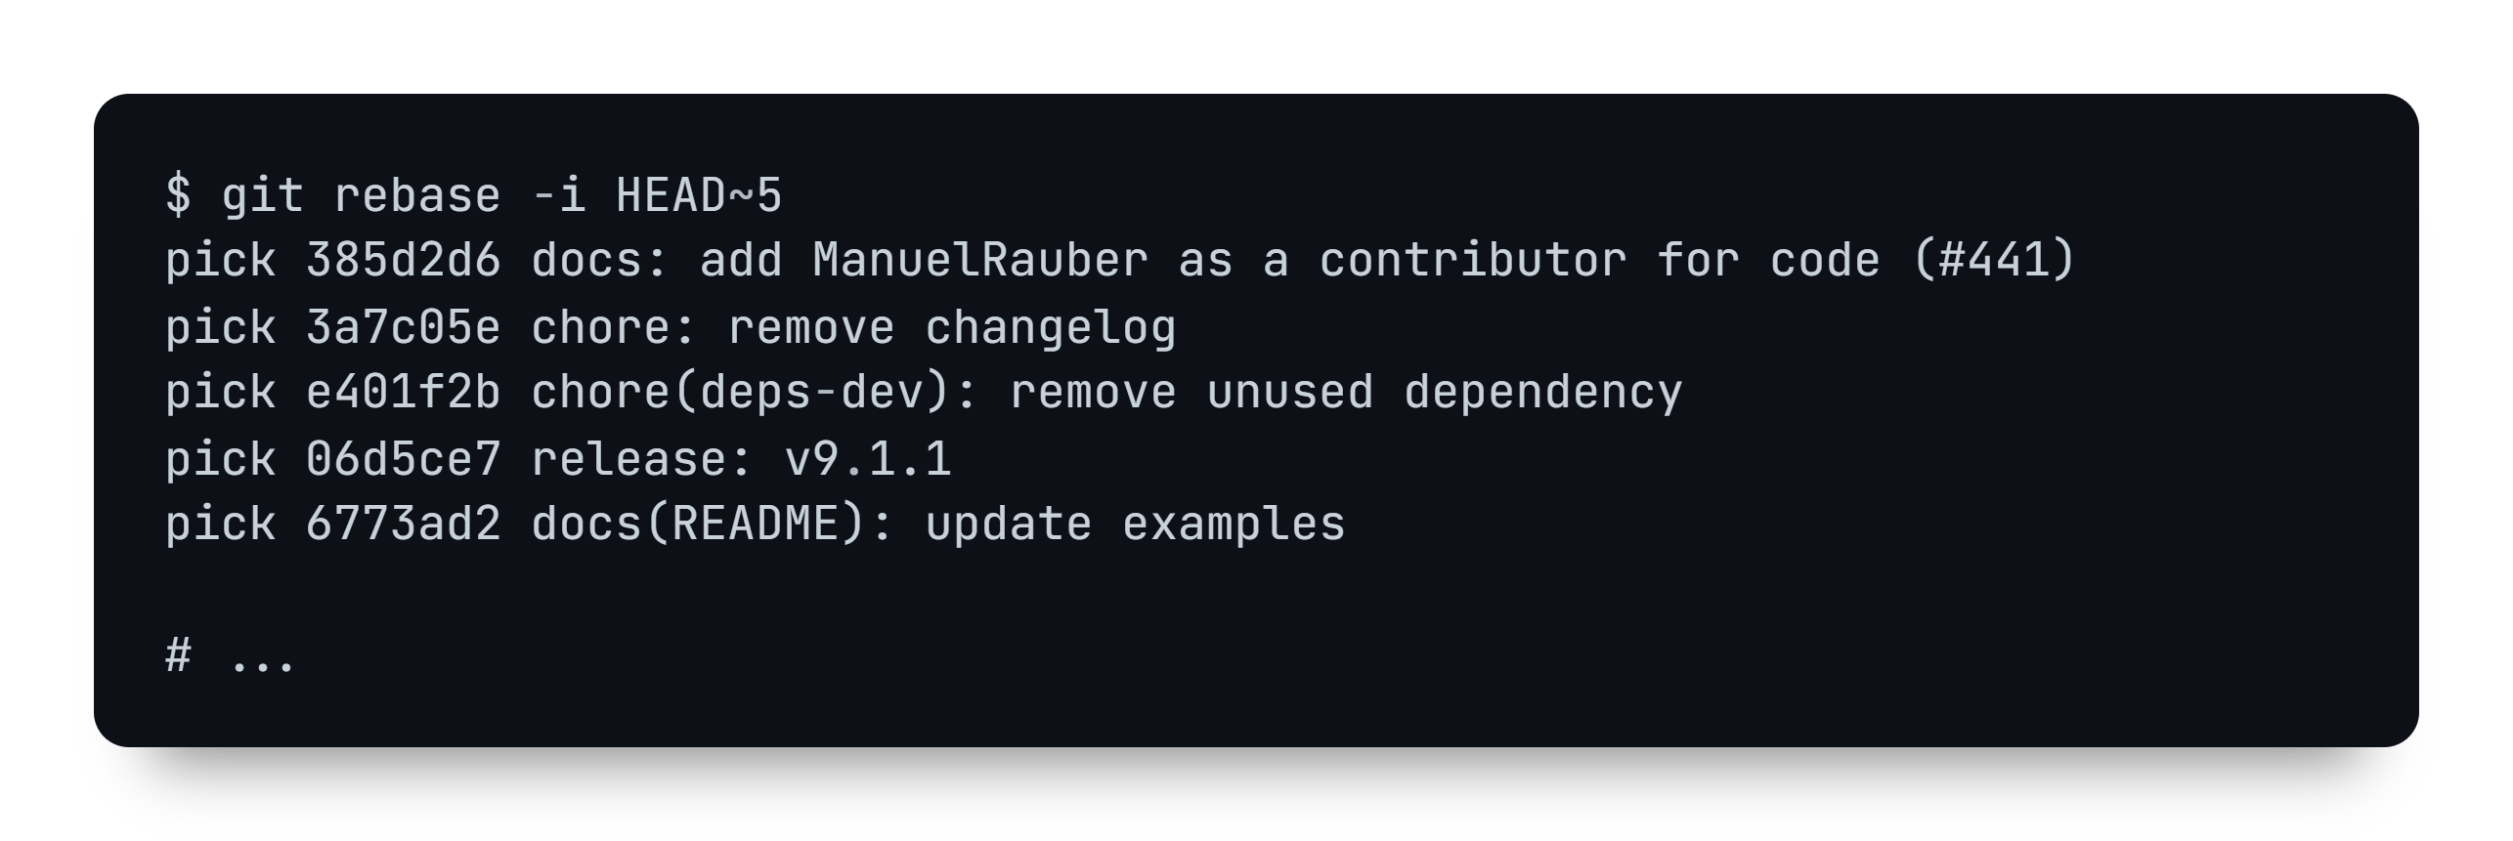
git rebase –i

Slide 32
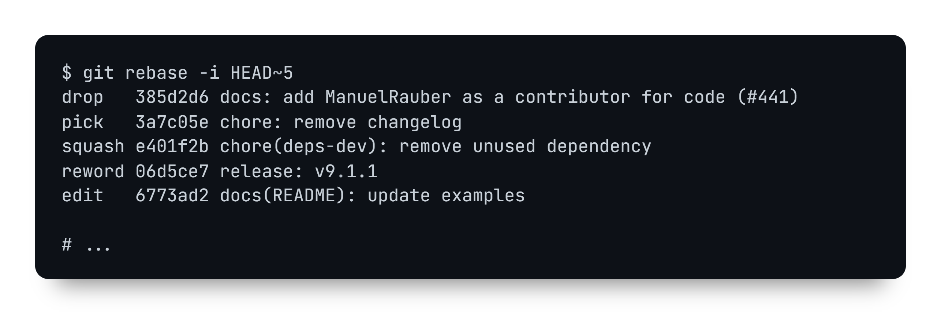
git rebase –i

Slide 33
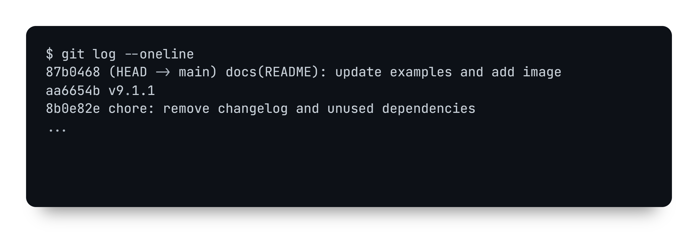
git rebase –i

Slide 34


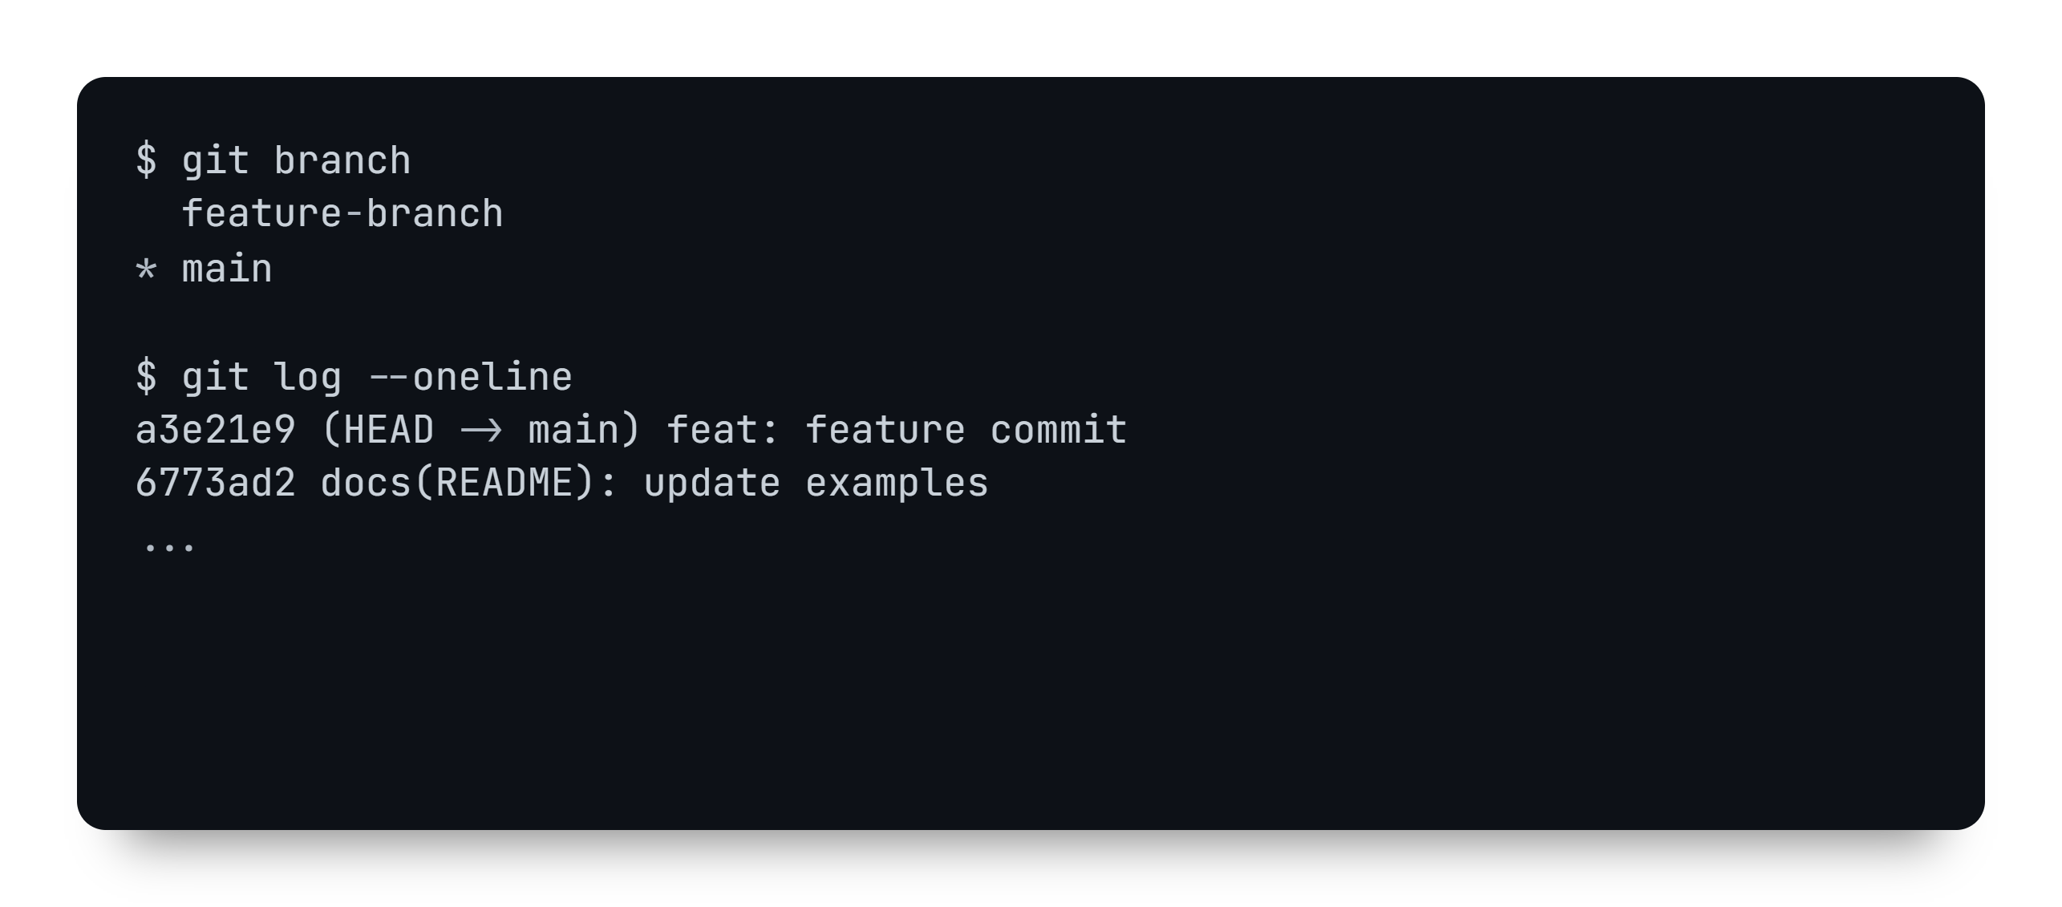
git cherry-pick

Slide 35
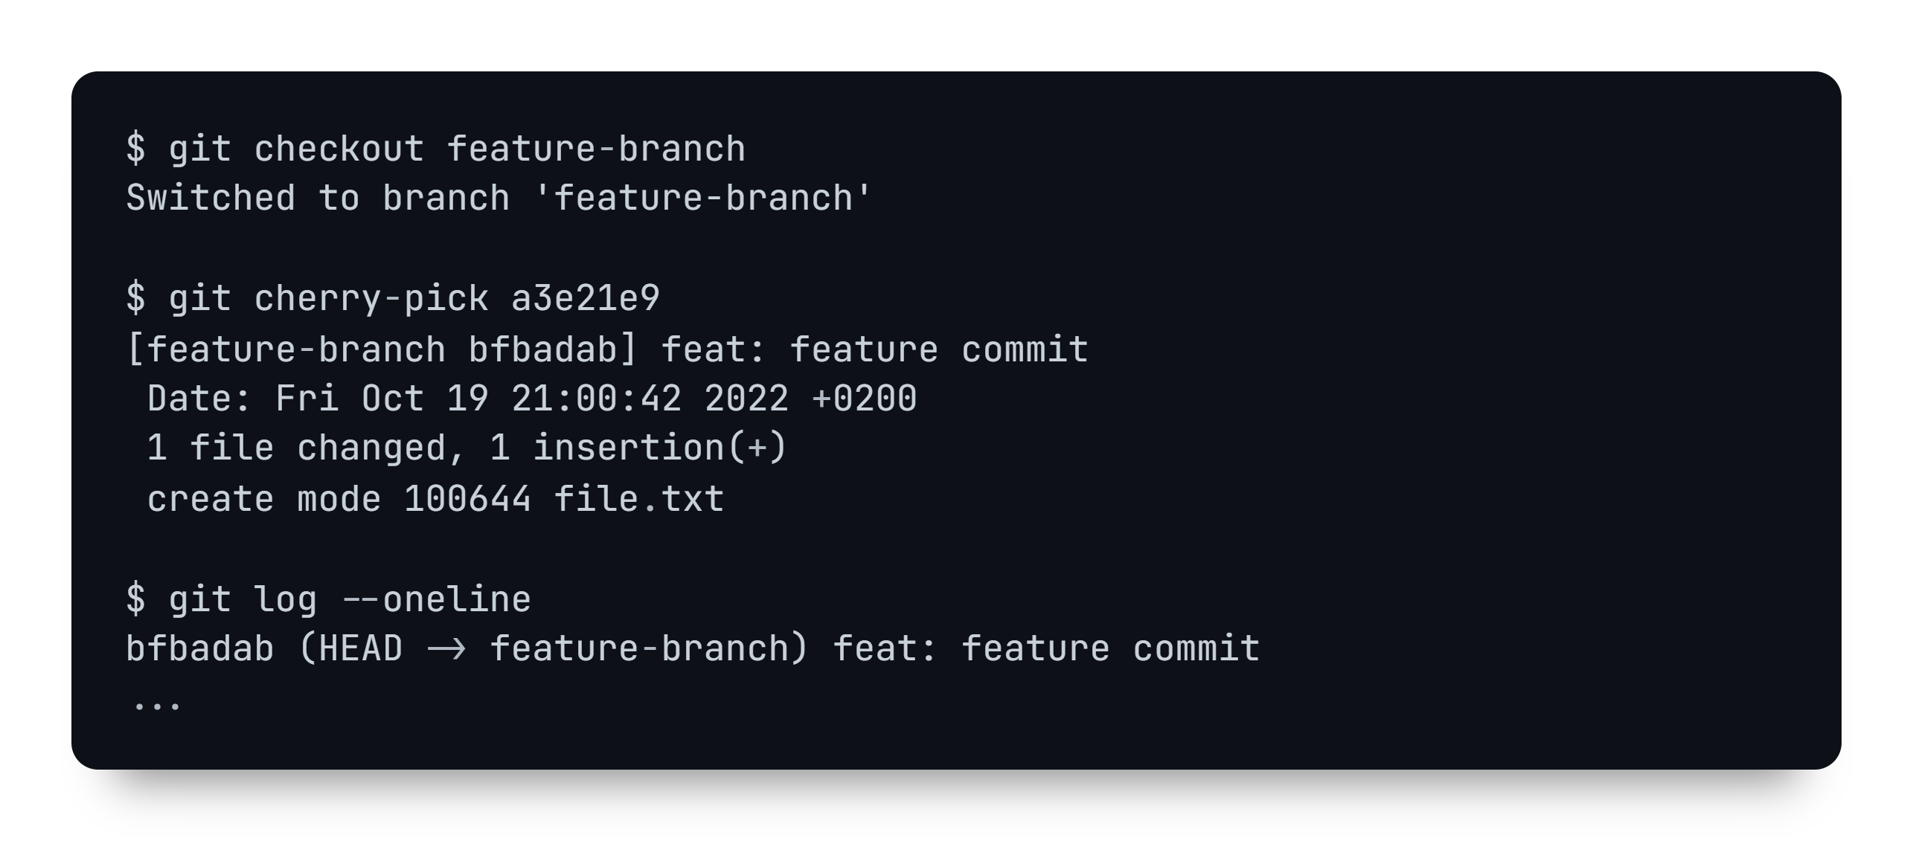
git cherry-pick

Slide 36
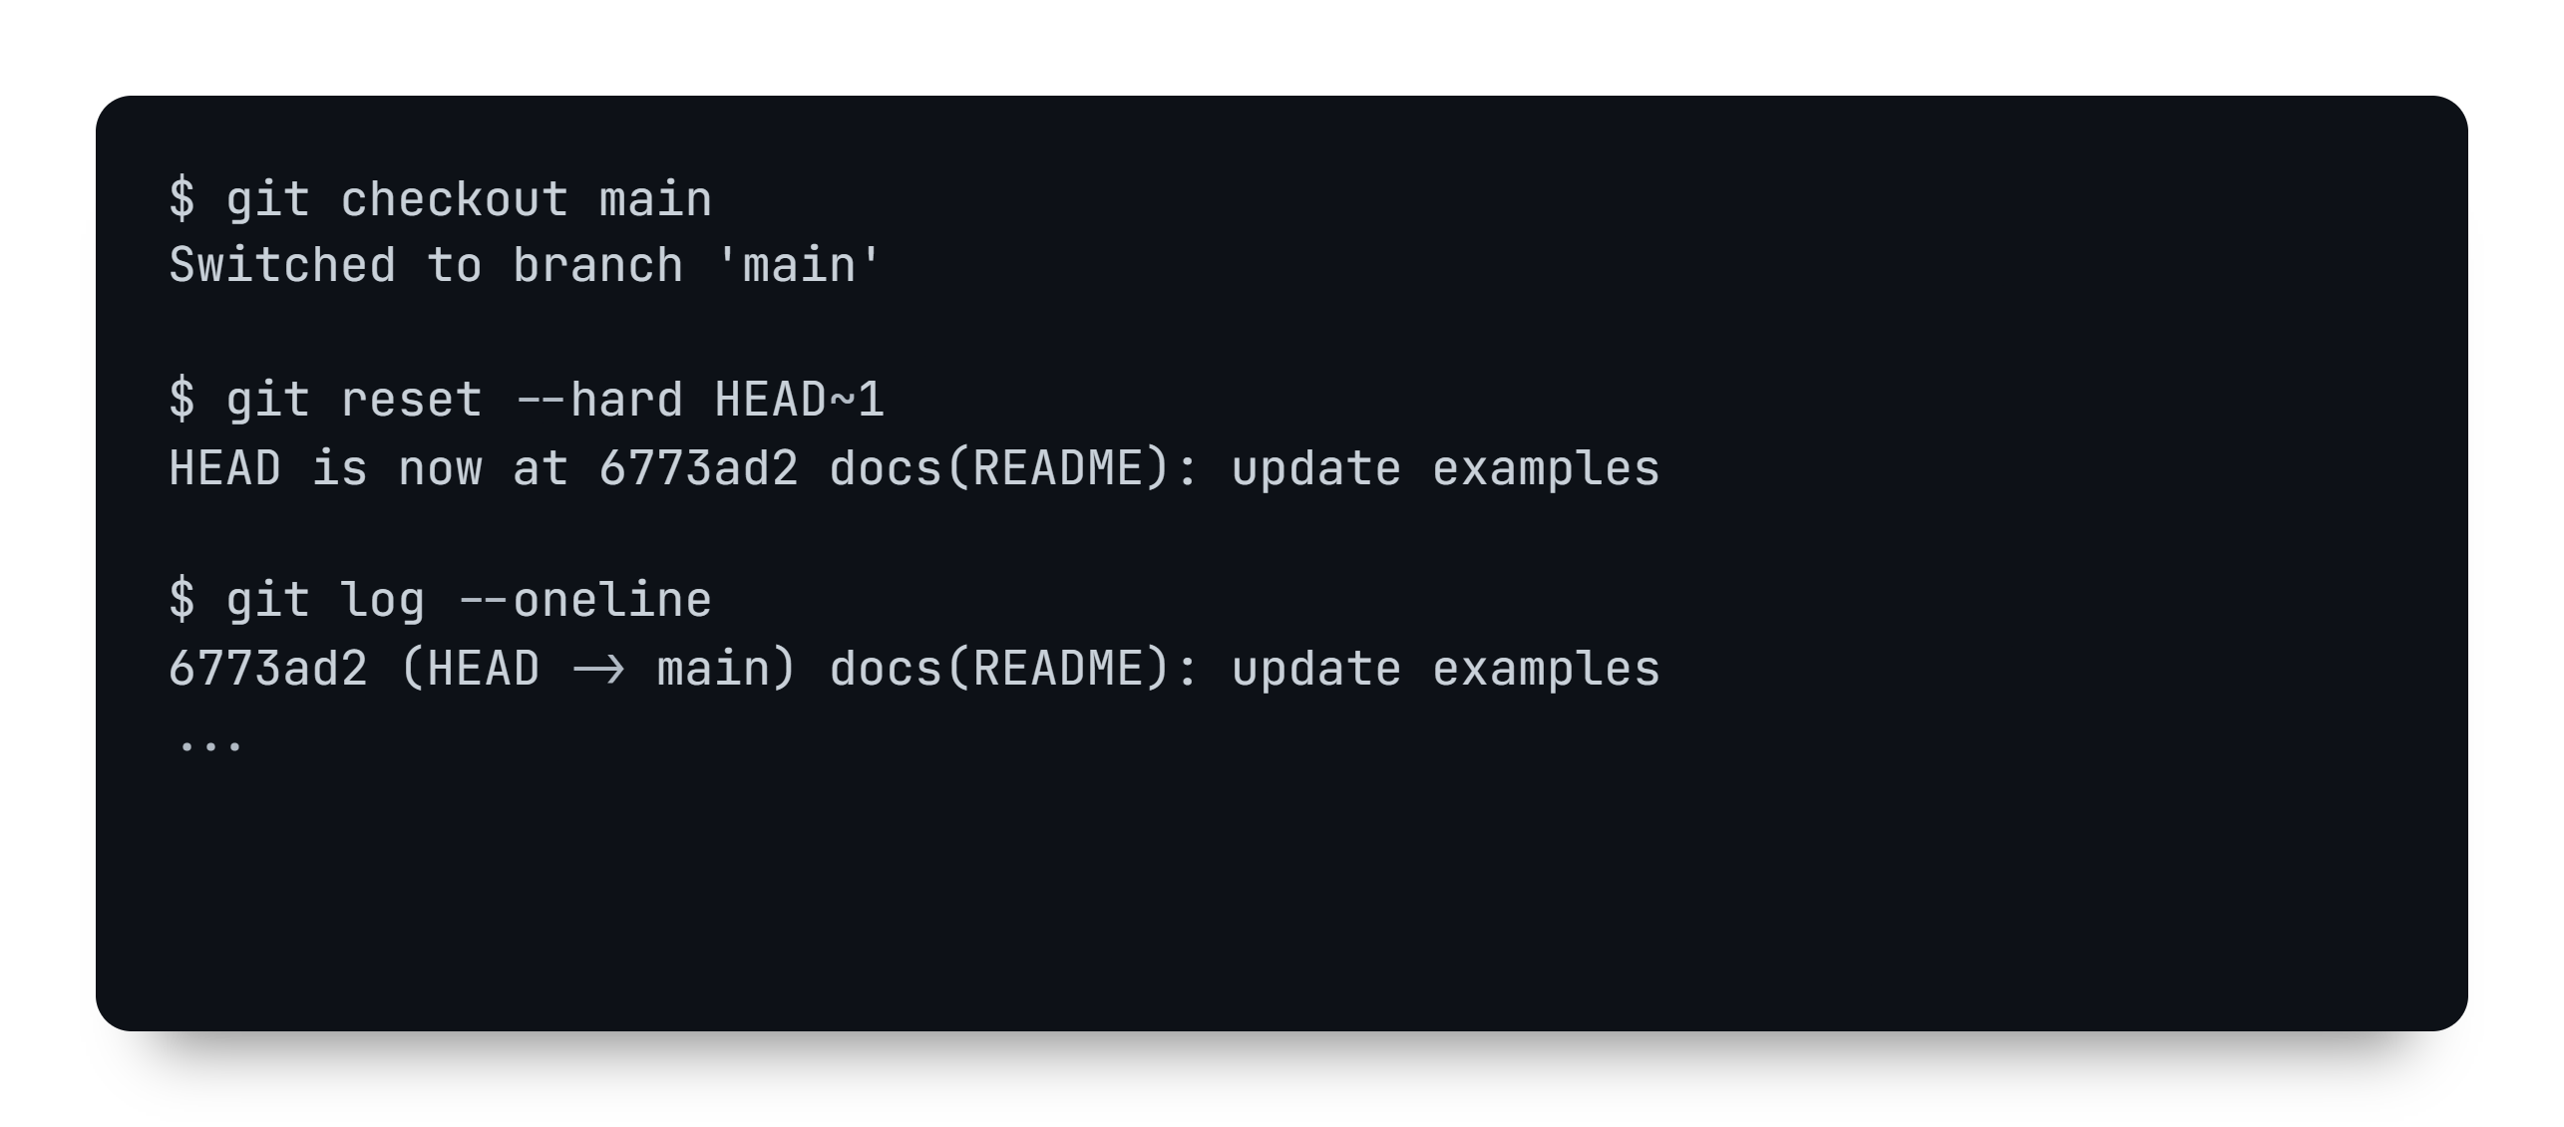
git cherry-pick

Slide 37

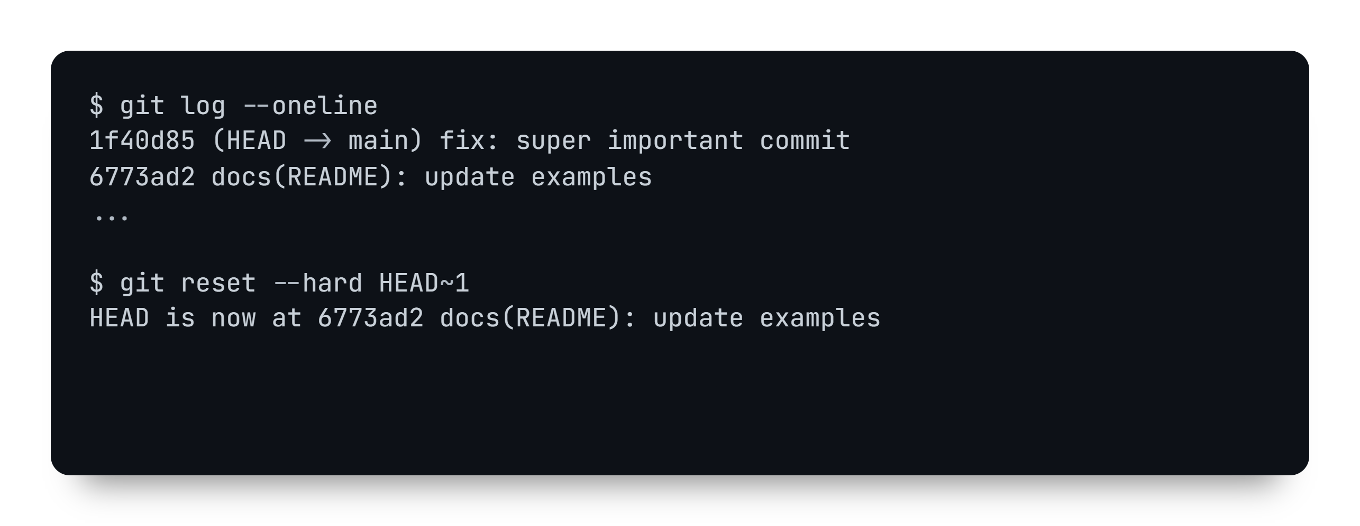
git reflog

Slide 38
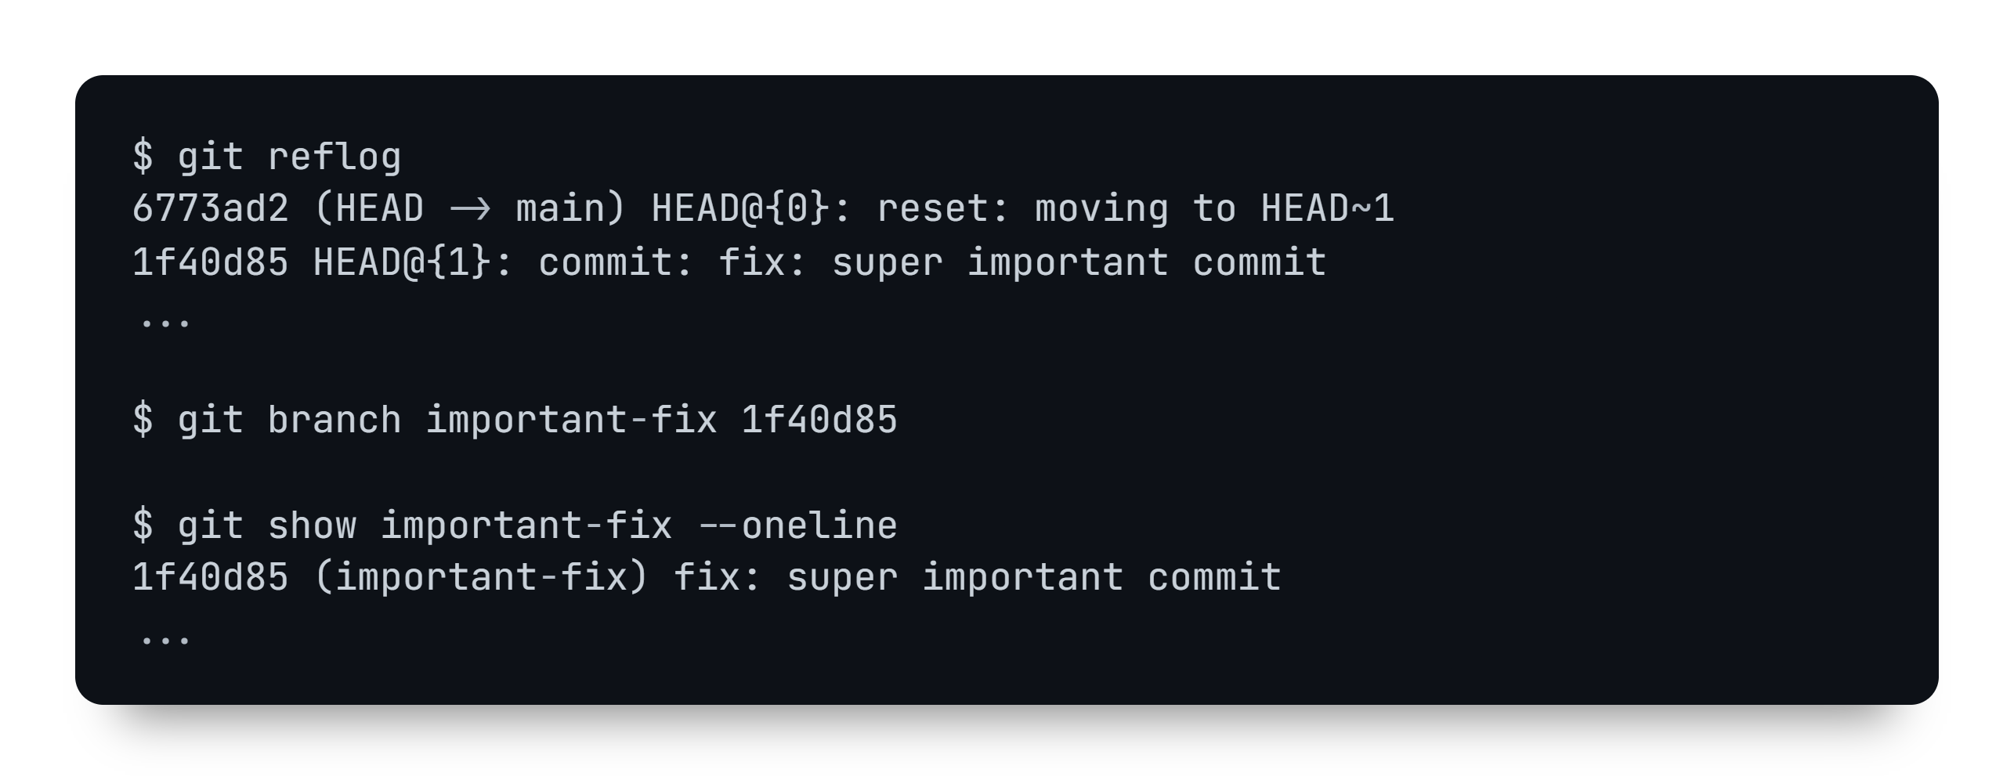
git reflog

Slide 39

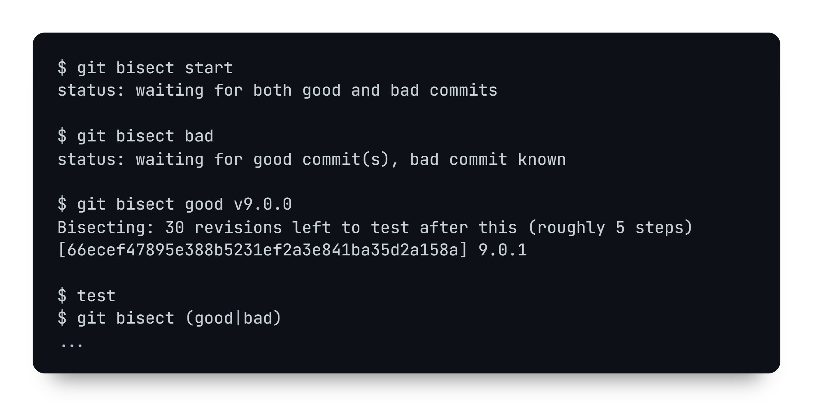
git bisect

Slide 40
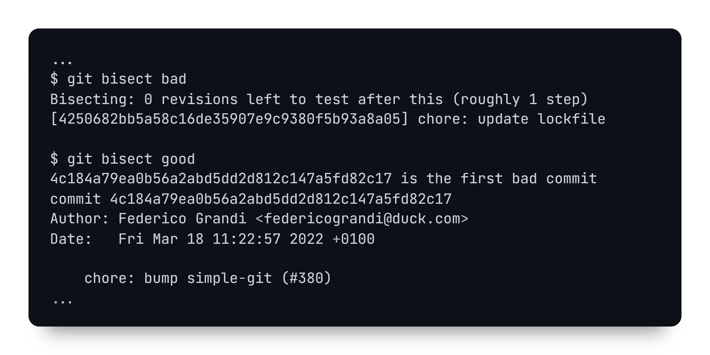
git bisect

Slide 41

Education
Any questions?
Federico Grandi - @EndBug - federicograndi@duck.com

